Slide 1
Supply analysis
How does supply impact rent growth?
How does supply impact rent-growth forecasts?
What happens in extreme cases of over/undersupply?
How good are the providers at forecasting stock?
Confidential – Not for Distribution

Slide 2
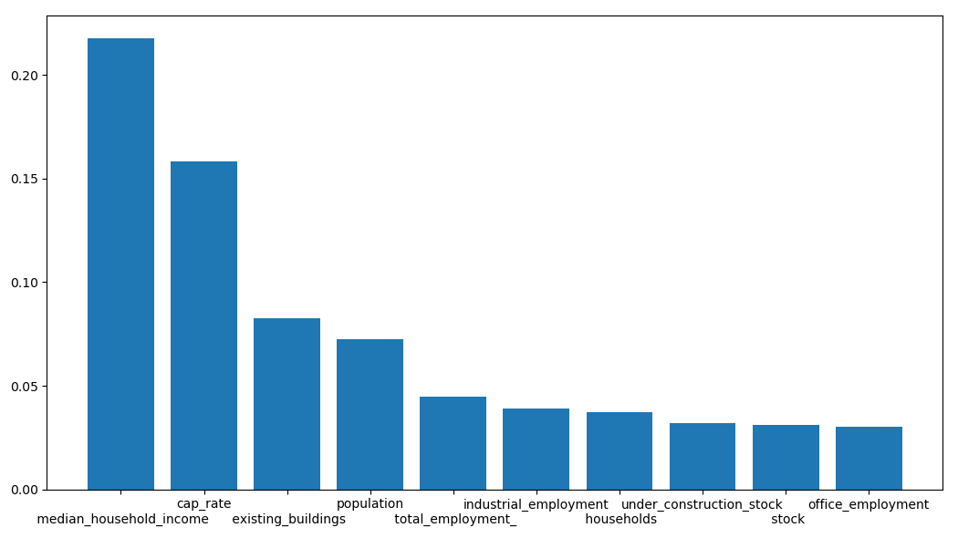
Change in Supply impacts rent growth (All Star)
Variance Explained
Confidential – Not for Distribution
Notes:
4-year back change; 4-year forward rent-growth

Slide 3
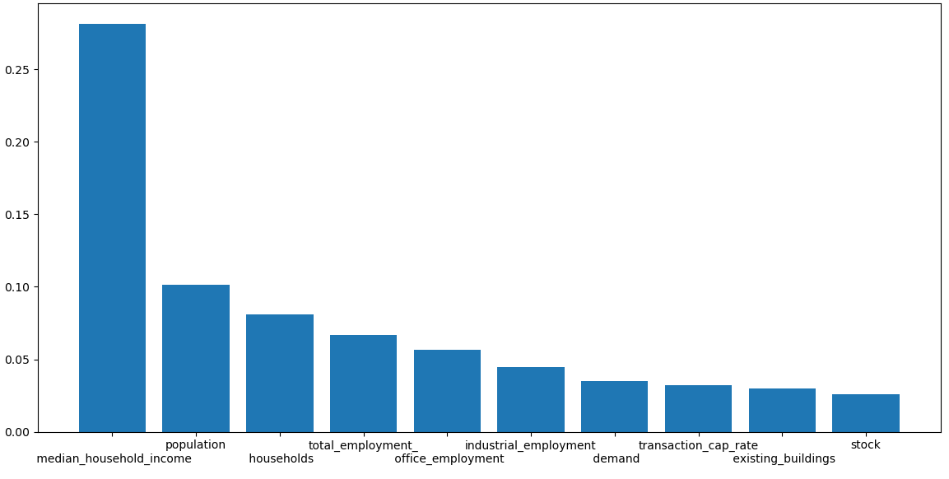
Change in Supply impacts rent growth (4&5-Star) Cap rate removed
Variance Explained
Confidential – Not for Distribution
Notes:
4-year back change; 4-year forward rent-growth

Slide 4
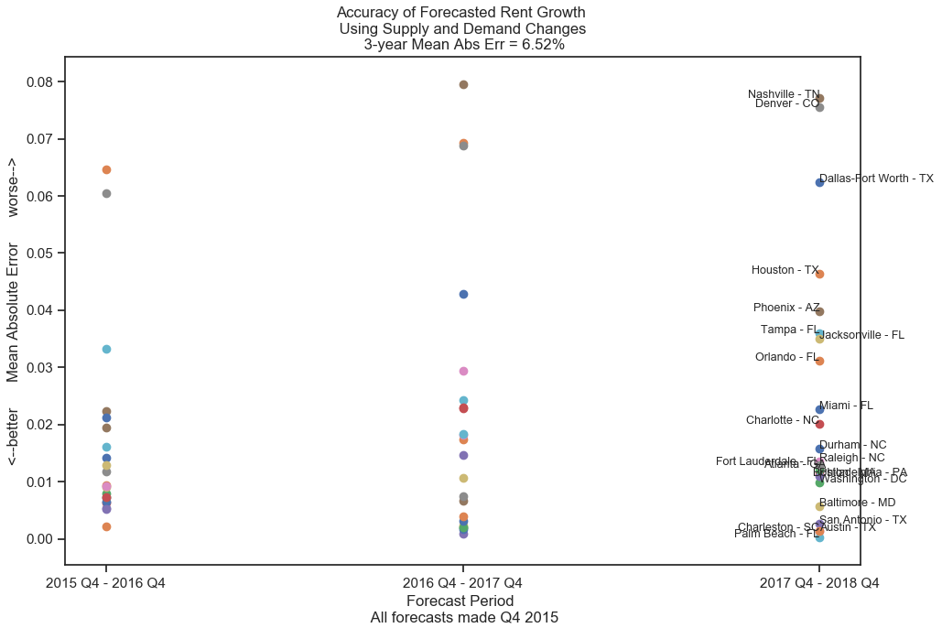
Using only HH and STOCK we can forecast rent growth
Confidential – Not for Distribution
Notes:
Yes; it is important;
Using Households minus stock (the amount to which an area is over/undersupplied

Slide 5
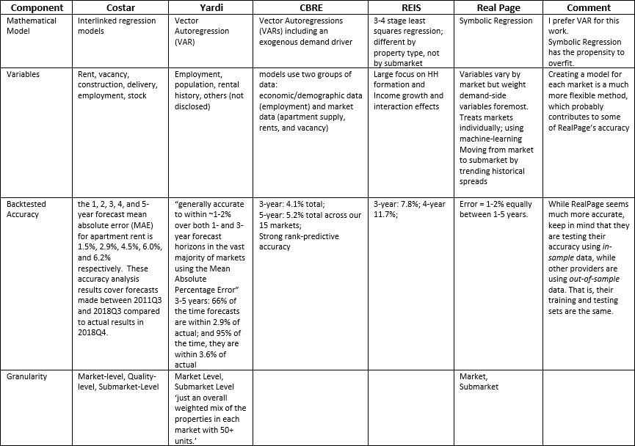
The data-providers use supply when forecasting
Confidential – Not for Distribution
Notes:
“stock”, “supply”, “formations”,

Slide 6
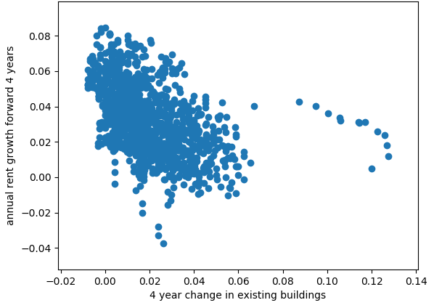
3-star rent growth vs supply (4-Year Change)
Confidential – Not for Distribution
Notes:
Supply changes forecast rent growth most over the 4-year horizon
The trend is as expected
This graph is for 3-star properties
Outliers are all Miami around 2008-2010

Slide 7
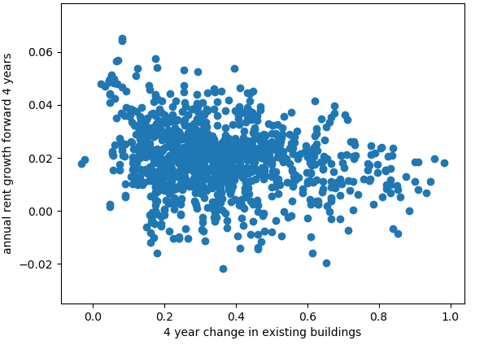
4&5-star rent growth vs building growth
(4-Year Change)
Confidential – Not for Distribution

Slide 8
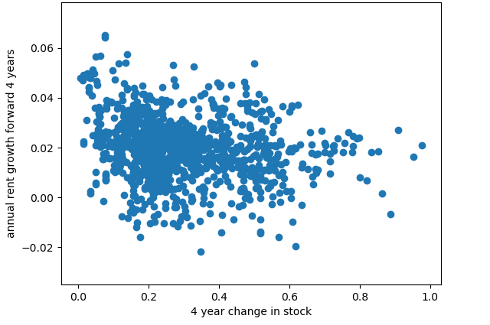
4&5-star rent growth vs stock growth
(4-Year Change)
Confidential – Not for Distribution

Slide 9
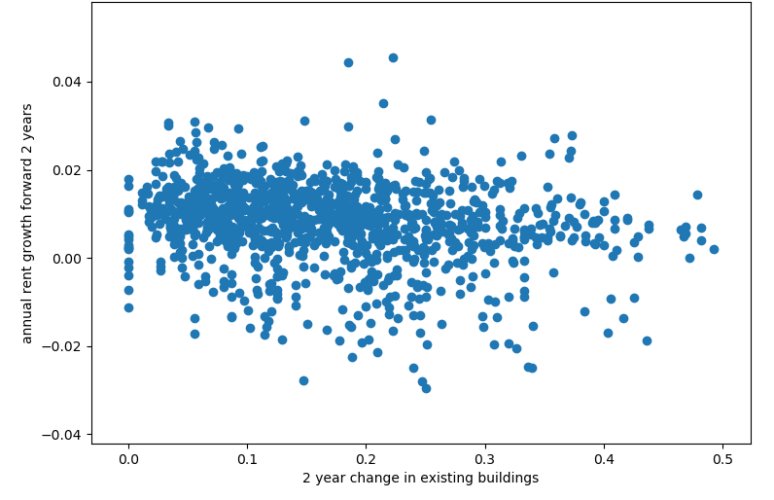
4&5-star rent growth vs building growth
(2-year change)
Confidential – Not for Distribution

Slide 10
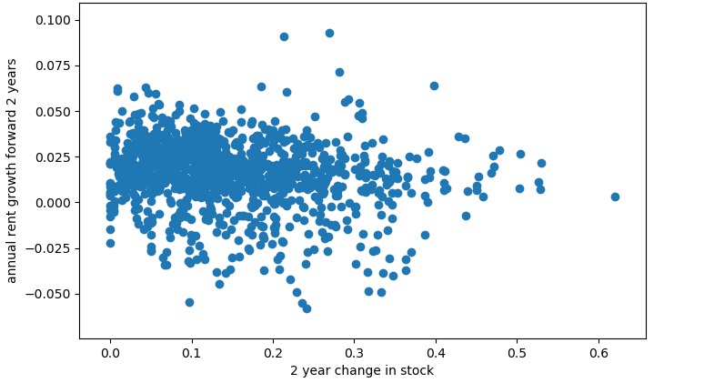
4&5-star rent growth vs stock growth
(2-year change)
Confidential – Not for Distribution

Slide 11
Supply forecast accuracy is not necessary
Rent-growth follows supply-growth with a 4-year lag.
Thus forecasting supply-growth itself is not necessary for forecasting rent growth
All that’s needed is the observed supply growth
Confidential – Not for Distribution

